Slide 1
ECGR 4146 PROJECT 1 PRESENTATION
GROUP 1
MARCH 28, 2018
Dhivya Sivalingam
Ryan Swaim
Andrew Szoke
Swathi Thirunarayanan

Slide 2
PROJECT OVERVIEW
Purpose: to “design, simulate, and synthesize a behavioral embedded microcontroller” in VHDL
Modules created:
Registers | PC | Memory
Decode Logic | IR | IM
ALU | Muxes | Stage Counter

Slide 3
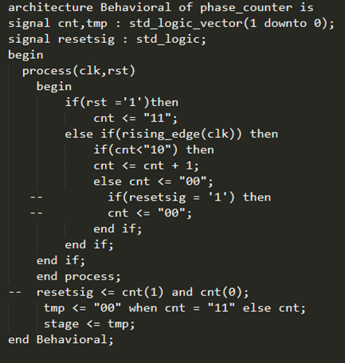
STAGE COUNTER
Keeps track of which of the three instruction stages the processor is in
Stage 0: Instruction is fetched by IR from the memory through the datain bus, PC is incremented
Stage 1: Immediate value is loaded in the Immediate register with value from its memory based on IRbit7.
Stage 2: Decode logic decodes the opcodes and corresponding operation is executed.

Slide 4
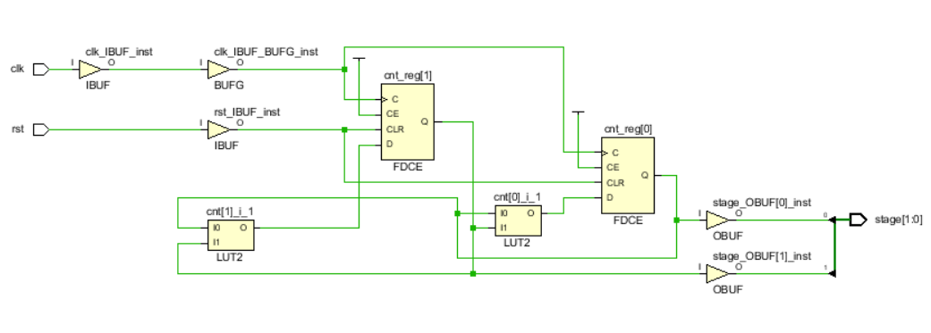
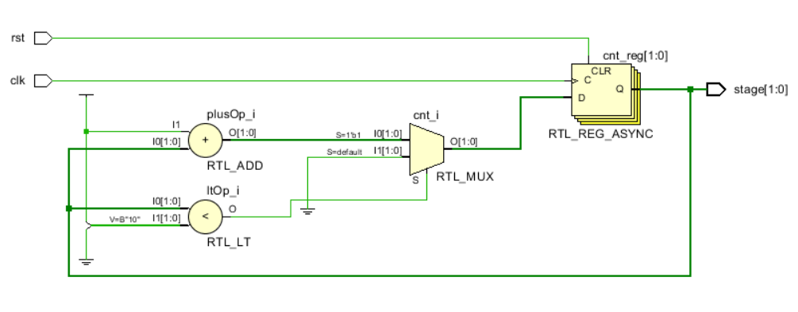
STAGE COUNTER (cont’d)
SYNTHESIZED DESIGN
ELABORATED DESIGN

Slide 5
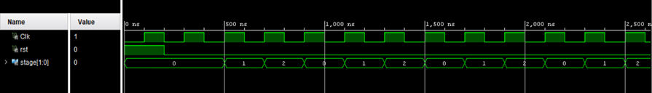
STAGE COUNTER (cont’d)
TESTBENCH RESULTS

Slide 6
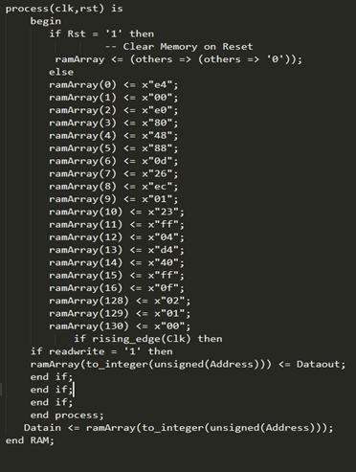
MEMORY
“Array of arrays” of bus width (8 bits)
Edge-triggered clock and reset inputs
Toggled by readwrite flag from the CPU
Synchronous write and asynchronous read

Slide 7
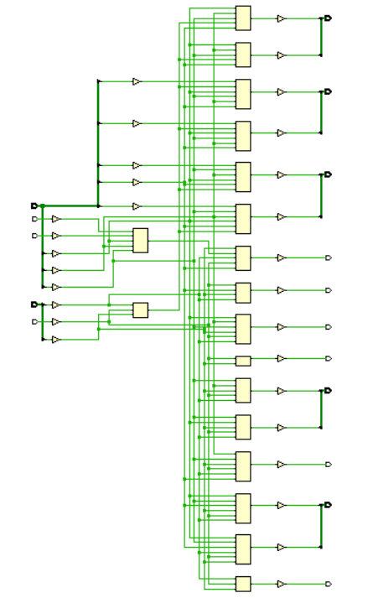

MEMORY (cont’d)
SYNTHESIZED DESIGN
ELABORATED DESIGN

Slide 8
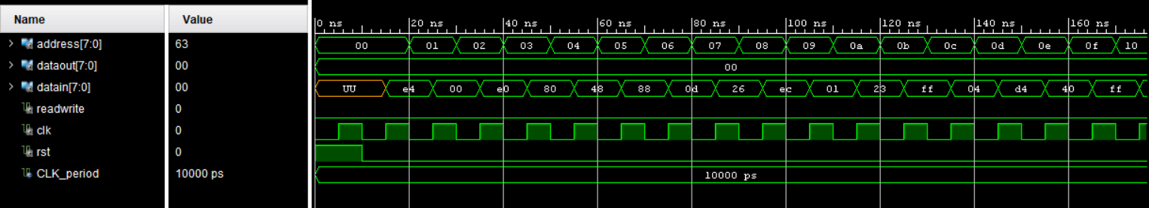
MEMORY (cont’d)
TESTBENCH RESULTS

Slide 9
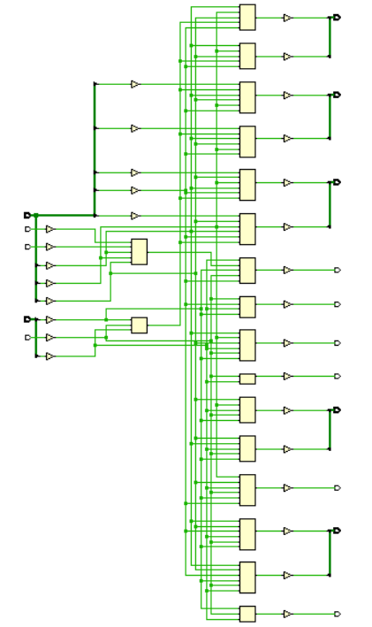
REGISTERS
8-bit, edge-triggered
Each register in register_file entity are within a registerfs wrapper
register_file: It has dwrite (acts as enable), dval (output of register mux) as input. zero, negative and registers r0 – r3 are the output.
Registerfs: Synchronous and registers are updated on rising edge of clock.
SYNTHESIZED DESIGN

Slide 10
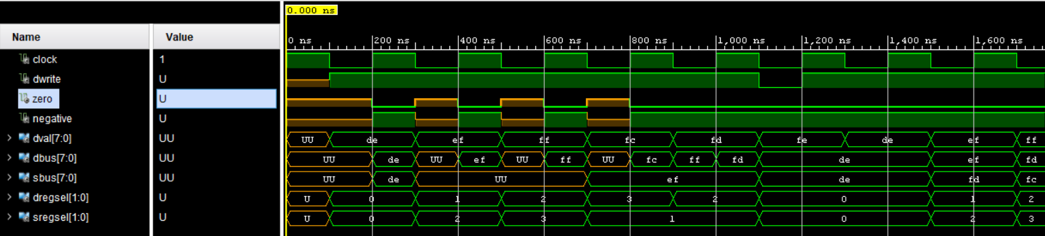
REGISTERS (cont’d)
TESTBENCH RESULTS

Slide 11
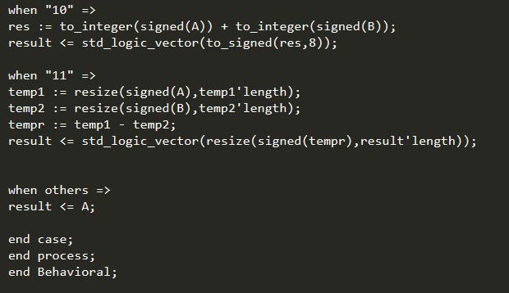
ALU
Two 8-bit inputs A and B and one 2-bit aluop selector
One 8-bit result vector

Slide 12
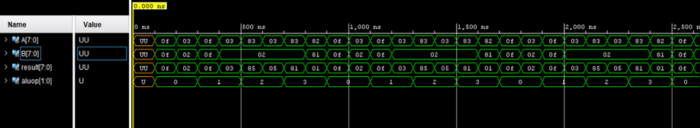
ALU (cont’d)
TESTBENCH RESULTS

Slide 13
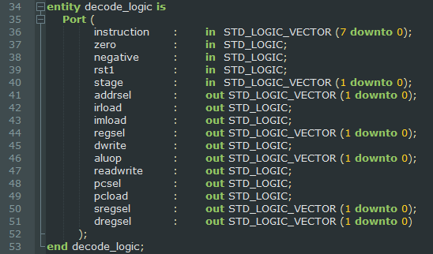
DECODE LOGIC
Controlling logic of the simulation
Contains four multiplexor components and one jump_logic component
Breaks instructions down into their individual components
Maps the components to the muxes, selects output and returns it

Slide 14

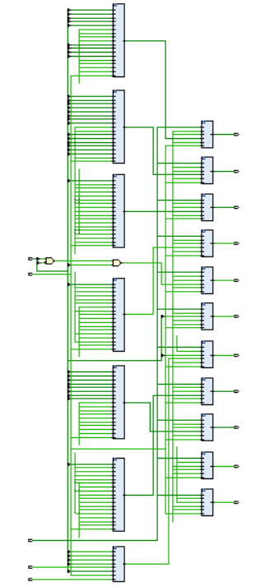
DECODE LOGIC (cont’d)
SYNTHESIZED DESIGN
ELABORATED DESIGN

Slide 15
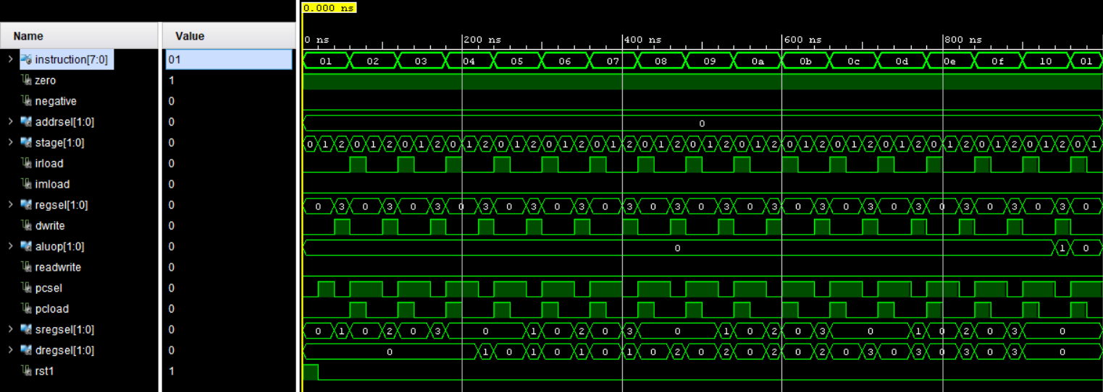
DECODE LOGIC (cont’d)
TESTBENCH RESULTS

Slide 16
MICROCONTROLLER
Highest level of simulation, connects all lower-level outputs to muxes
Components within the architecture:
phase_counter s8_2x1_mux PC
ALU s8_4x1_mux decode_logic
register_file IR memory

Slide 17
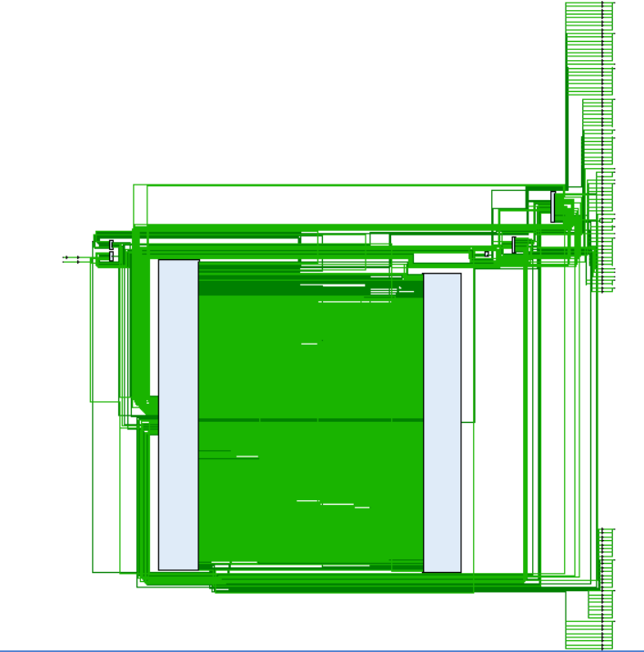
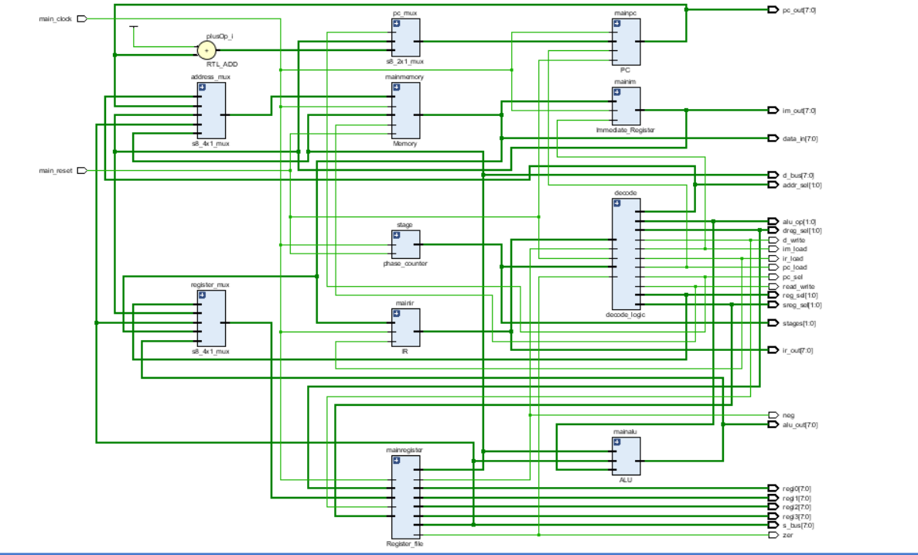
MICROCONTROLLER (cont’d)
ELABORATED DESIGN
SYNTHESIZED DESIGN

Slide 18
ISSUES FACED
Stage counter was unlike normal counter (increments after reset 0 value). In Stage counter, the counter should start from 0 after reset.(During reset counter is 0. So the counter value should be in the following manner if we reset the counter first:
Reset Stages
Normal counter 0 1 2 3 …..
Stage Counter 0 0 1 2 0 1 2 ….
Understanding output of IR and IM register. The output of IR and IM registers were delayed by one clock cycle. That is, the output of stage 0 was found during next clock cycle (stage 1) in IR and the output of stage 1 was found during stage 2 in IM register.

Slide 19
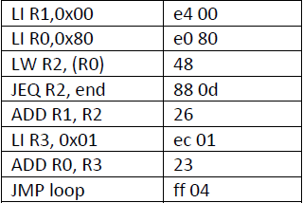

EXAMPLE CODE

Slide 20
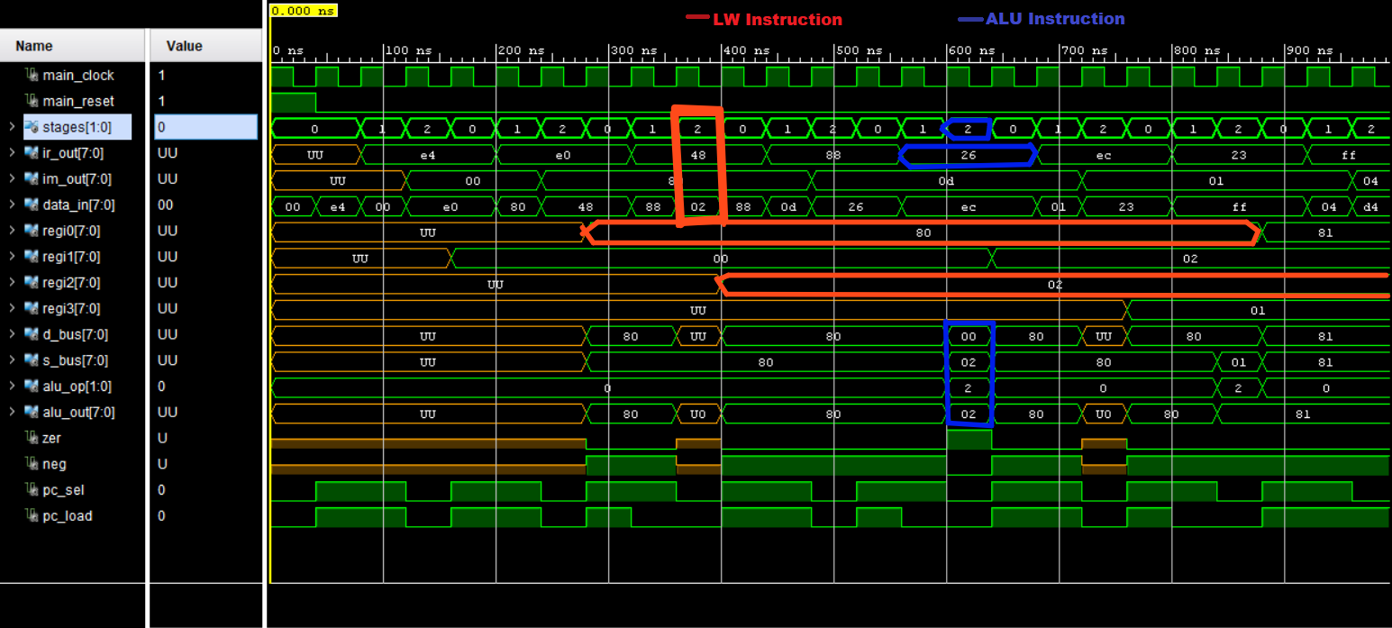
MICROCONTROLLER (cont’d)
WAVEFORM RESULTS

Slide 21
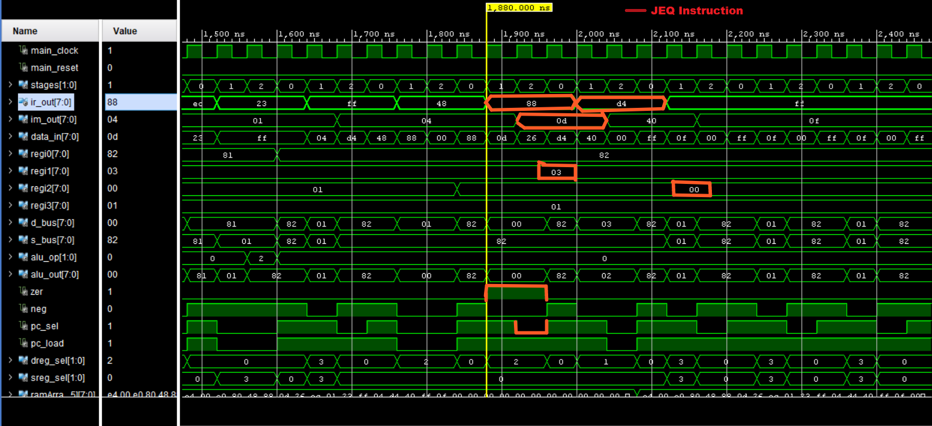
MICROCONTROLLER (cont’d)
WAVEFORM RESULTS

Slide 22
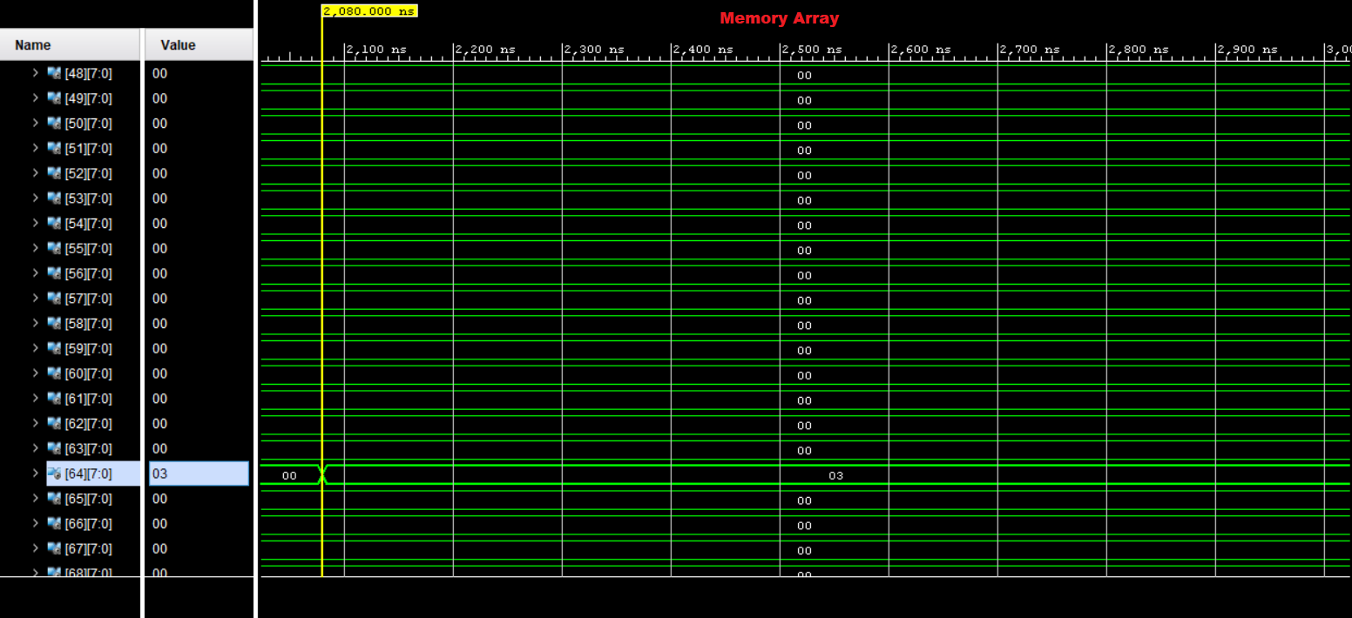
MICROCONTROLLER (cont’d)
WAVEFORM RESULTS

Slide 23
QUESTIONS?

